Slide 1
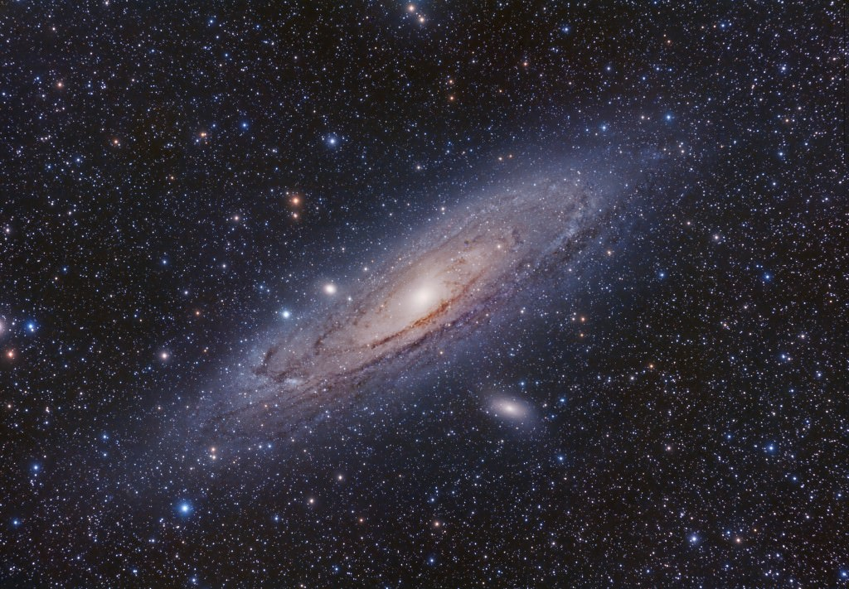


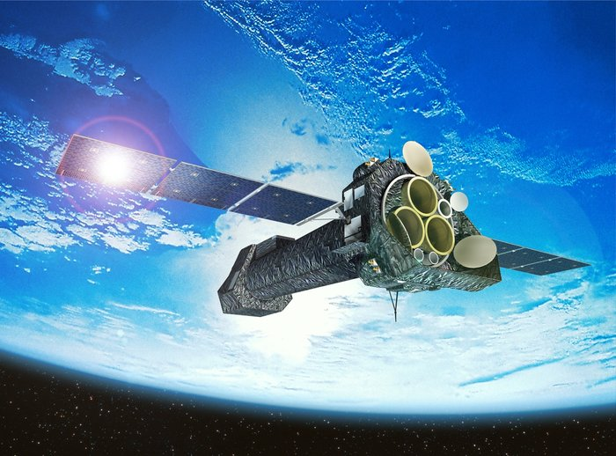
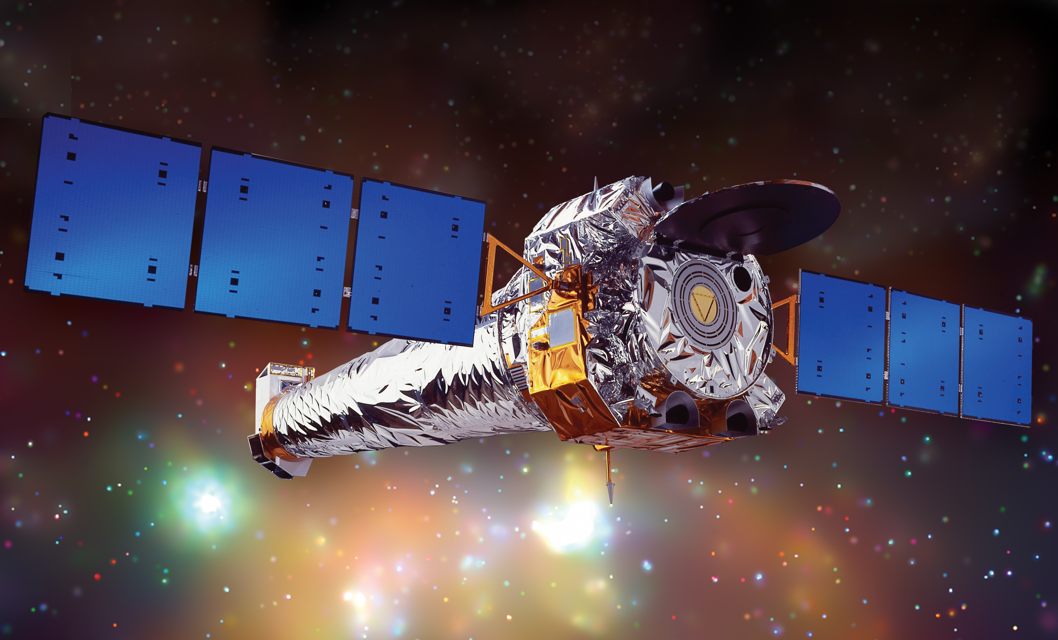
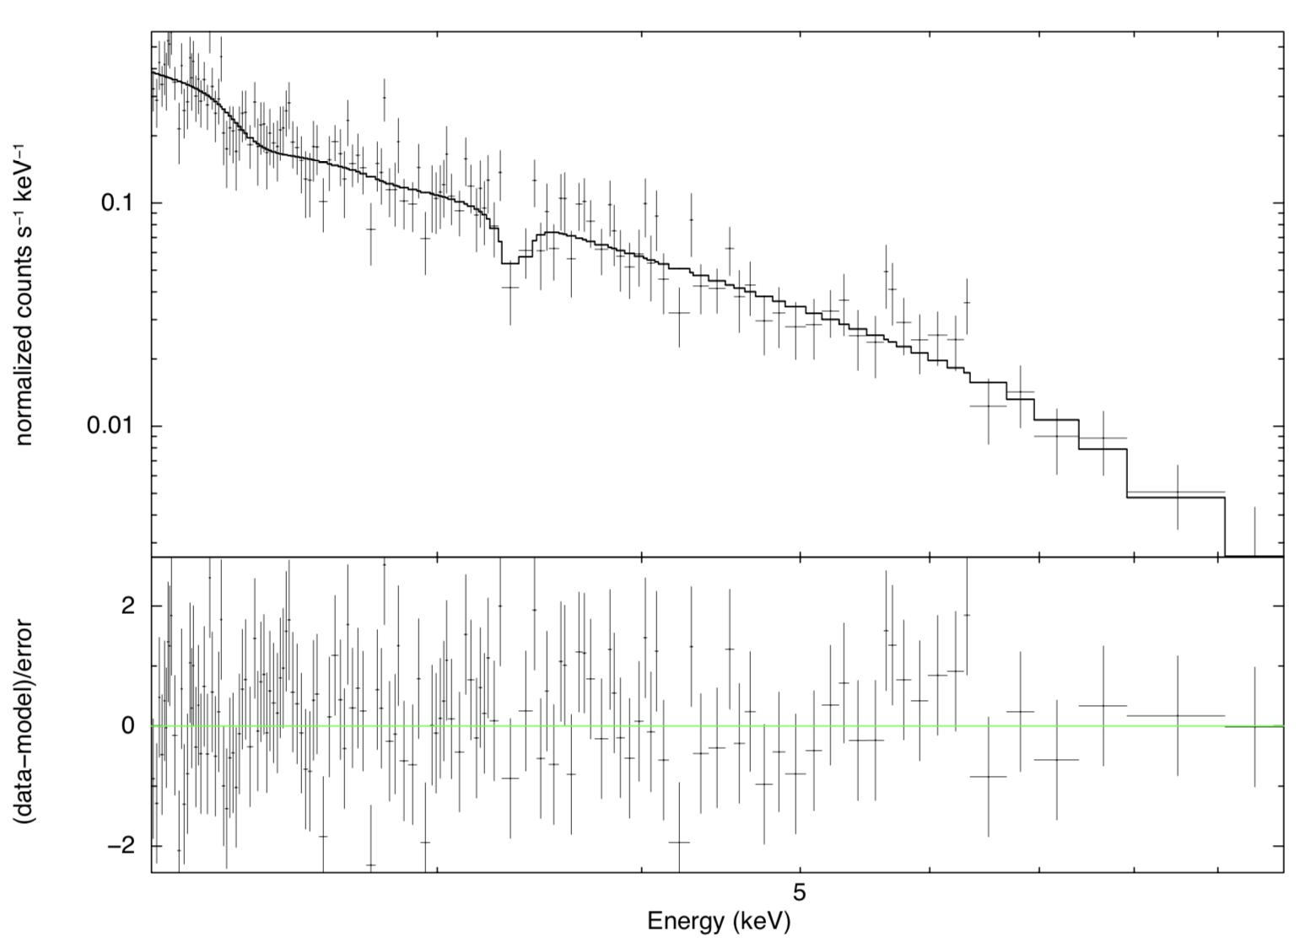
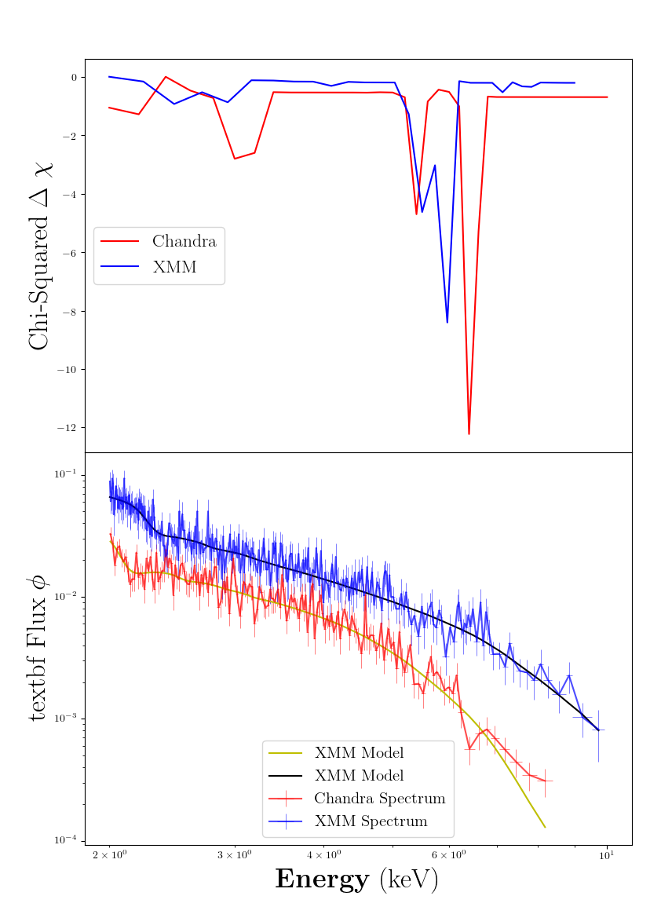
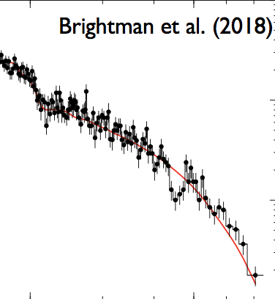

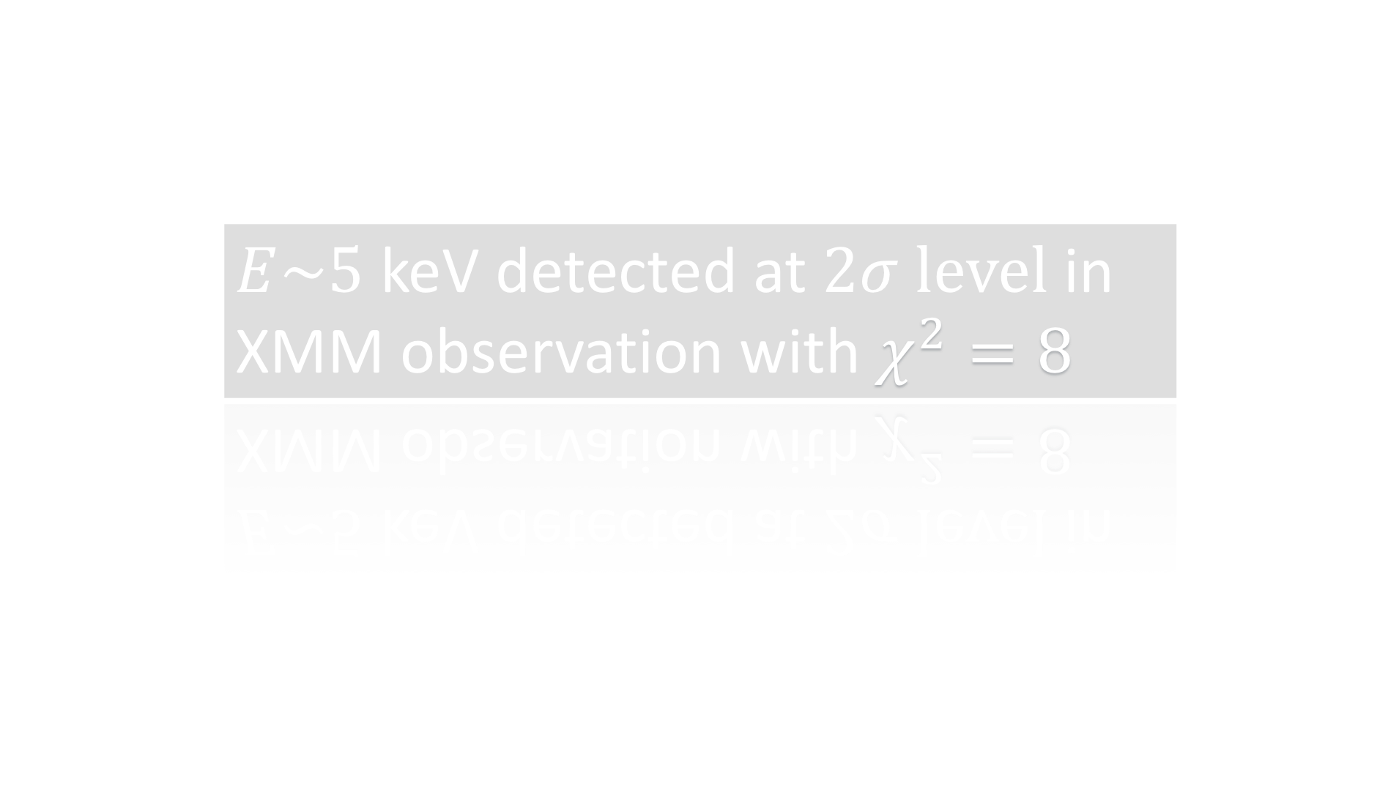










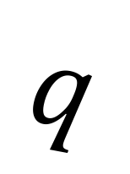
A systematic search for absorption features in the X-ray spectra of ultraluminous X-ray sources
A. Sosanya^{1,2}, M. Brightman¹, F.A Harrison¹, H.P Earnshaw¹, K. Madsen¹, M. Heida¹, D.J Walton³
STAR POWER
Ultraluminous X-ray sources (ULXs) are variable, non-nuclear bright X-ray sources in nearby galaxies not associated with the central supermassive black hole. These ULXs are brighter than black hole systems in our galaxy—they have super-Eddington luminosities greater than stellar mass black holes. These ULXs break the Eddington theory because there are extreme accretion rates onto a compact stellar remnant, or an intermediate mass black hole. It was previously thought that only black hole accretion could power ULXs, but the discovery of pulsations has shown that neutron stars may also power ULXs. Using the data from the XMM-Newton and Chandra X-ray observatories, we conducted a systematic search to find cyclotron resonance scattering features in the X-Ray spectra of ULXs to identify neutron-star powered ULXs. The results may findings provide further insight into the analysis techniques for future neutron star-powered ULXs and estimation of their magnetic field strengths.
(left)
XMM-Newton
(right)
Chandra X-Ray Observatories
RESULTS
The systematic search found three strong candidates for analysis: Holmberg II X-1, IC 342, and M32.
HOLMBERG II
Absorption feature detected in Holmberg II at $E\sim 3.35$ keV, yet $χ^{2}=6$
EDDINGTON LUMINOSITY
The Eddington Luminosity is the maximum luminosity a star attains when radiation pressure from the star and gravitation pressure are balanced.
$${ G}_{NS}$$
$$F_{rad}$$
NS
$\frac{dP}{dr}=\frac{kp}{c}F_{rad}$ = $\frac{GMp}{r^{2}}$, where $F=\frac{L}{4πr^{2}}$
$${ L}_{ed}=\frac{4πGc}{k}M$$
(Above) XSPEC plot of Holmberg II spectrum, shjowing absorption feature at 3.3 keV
CRSFs
$$E_{3}$$
IC-342
The energy transitions between Landau levels induce CRSFs and are present in spectra. Cyclotron lines imply the presence of a magnetized neutron star and give a measurement of its field strength.
$$q$$
$$E_{1}$$
$$E_{2}$$
$E\sim 5$ keV detected at $2σ level$in XMM observation with $χ^{2}=8$
$$B$$
$$E=0$$
Although IC-342 showed statistical promise with $χ^{2}=8$, there were no visible features detected within the continuum.
(Above)
A 2-D representation of Landau levels
M32
(Right) Cyclotron line found in M51’s ULX-8 found by M.Brightman, now believed to be neutron-star powered.
The ULXs observed in M32 are proximate to each other, and therefore needed Chandra data for spatial resolution.
METHODS
Absorption lines found in two different observations
$E\sim 6$ keV detected at $3σ level$in XMM observation with $χ^{2}=8$
$E\sim 6.5$keV detected at $2σ$ level in Chandra observation with $χ^{2}=12$
SYSTEMATIC SEARCH
Cross-referenced the Serendipitous XMM-Survey to find ULXs with at least 10,000 intensity counts.
SPECTRAL ANALYSIS
Different energies between XMM’s and Chandra’s M32 observation may be due to
change in orientation of magnetic field between observations.
possibility of an Iron outflow at one of the energies.
Either may be a statistical fluctuation.
Contributions from the two proximate X-Ray sources are additive.
Reduced XMM and Chandra data and found favorable spectral extraction parameters using Chi Squared test.
Used spectral fitting software XSPEC to analyze detector data and fitted the spectra with a coupled cutoff power law continuum and Gaussian absorption (zgauss).
Ran simulations to assess false alarm rate from statistical fluctuations.
(Right) Contour and flux plots of Chandra and XMM observations of M32
CONCLUSION
Holmberg II and M32 show the absorption-like features that may be , but future observations are needed to gather more data on these sources. The possibility of atomnic absoption, namely Iron, cannot be ruled out. To consolidate our findings, spectral data needs to be compared across detectors.
ACKNOWLEDGEMENTS
Caltech WAVE Fellows Program
SoCal Edison
REFERENCES
M. Brightman et al. 2018
H.P. Earnshaw et al. 2018
M. Bachetti et al. 2014
D.J Walton et al. 2016

